Slide 1
Introduction to GAMS
Water Resources Planning and Management
Daene C. McKinney

Slide 2
Introduction To GAMS
GAMS = General Algebraic Modeling System
GAMS Guide and Tutorials
  http://gams.com/docs/document.htm ← Doc’s here
GAMS website
  www.gams.com
  http://gams.com/download/ ← Download here
McKinney and Savitsky Tutorials
  http://www.caee.utexas.edu/prof/mckinney/ce385d/Lectures/McKinney_and_Savitsky.pdf ← Doc’s here

Slide 3
Example Problem
Write a GAMS model and solve the following nonlinear program using GAMS

Slide 4
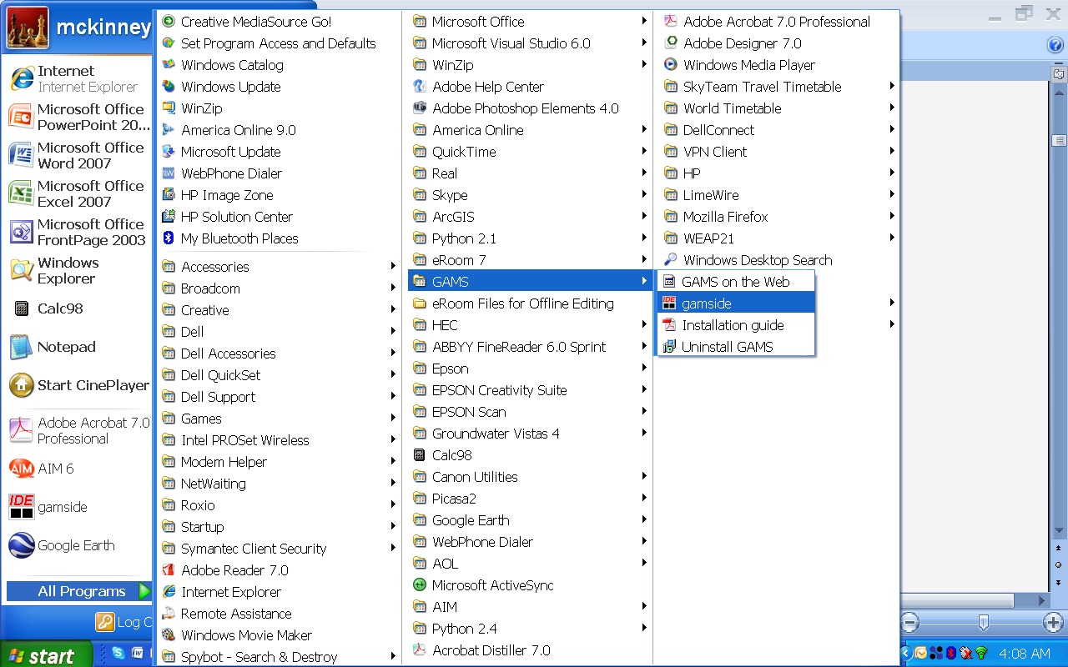
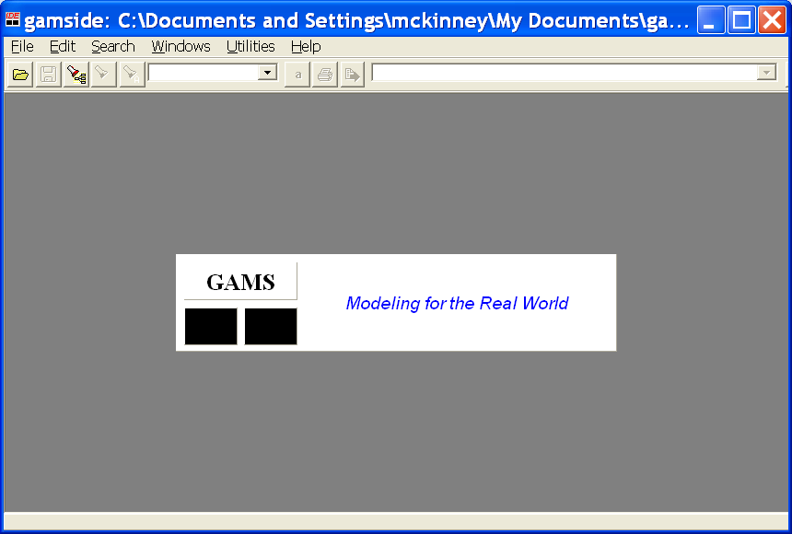
Start GAMS
Start GAMS by selecting:
    Start → All Programs → GAMS → GAMSIDE

Slide 5
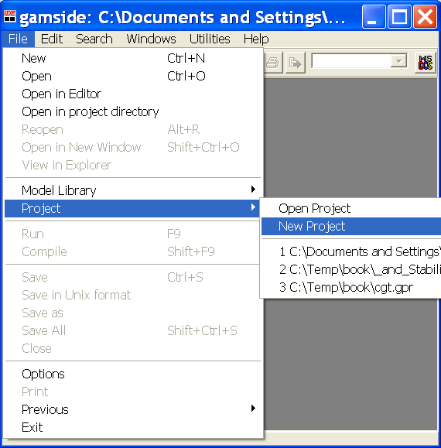
Create New GAMS Project
Choose from the GAMSIDE:
    File → Project → New project

Slide 6
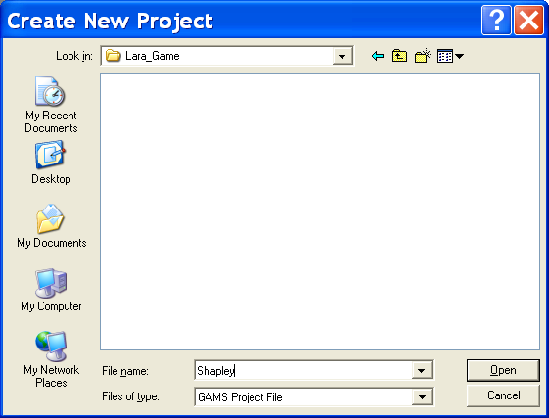
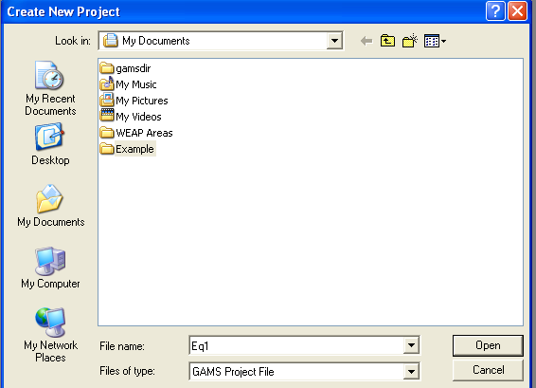
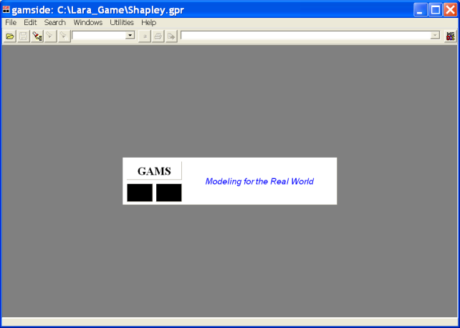
Name New GAMS Project
In “My Documents”
Create a new directory by pressing the “folder” icon.
Name the new folder “Example”
Double click on “Example” folder
Type “Eq1” in the “File Name” box
Press Open

Slide 7
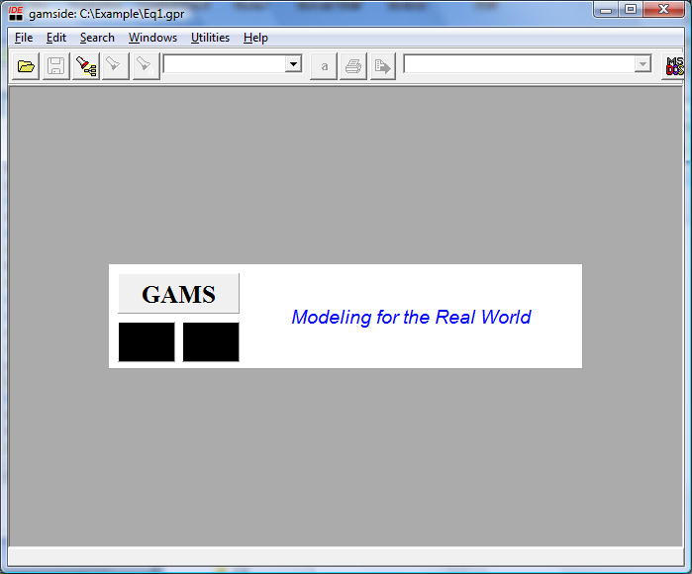
New Project
The GAMS window should now show the new Eq1.gpr project window

Slide 8
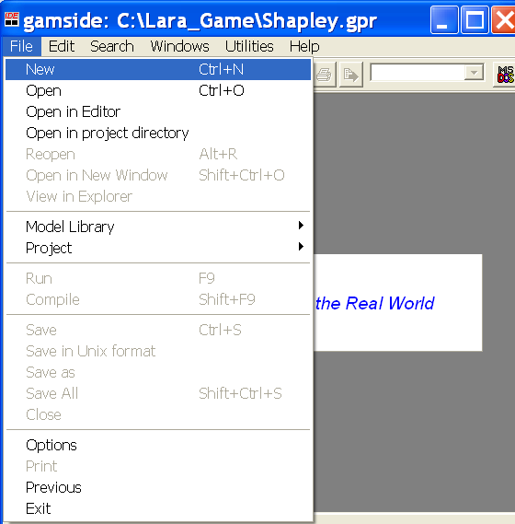
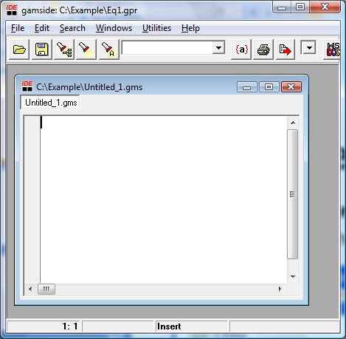
Create New GAMS Code File
Select: File → New
You should see the new file “Untitled_1.gms”

Slide 9
Enter GAMS Code
The Model
The code
VARIABLES Z, X1, X2, X3;
EQUATIONS F ;
F.. Z =E= X1+2*X3+X2*X3-X1*X1-X2*X2-X3*X3 ;
MODEL HW41 /ALL/;
SOLVE HW41 USING NLP MAXIMIZING Z;
FILE res /HW41.txt/;
PUT res;
put "Solution X1 = ", put X1.L, put /;
put " X2 = ", put X2.L, put /;
put " X3 = ", put X3.L, put /;
Define Variables
Define Equations
Define Model
Solve Model
Write Output

Slide 10
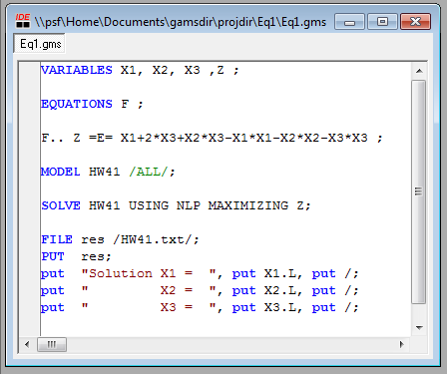
Enter GAMS Code
The Model
The code

Slide 11
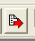
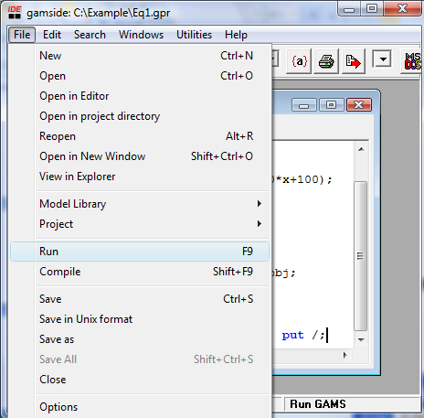
Run the Model
Select: File → Run, or Press the red arrow button

Slide 12
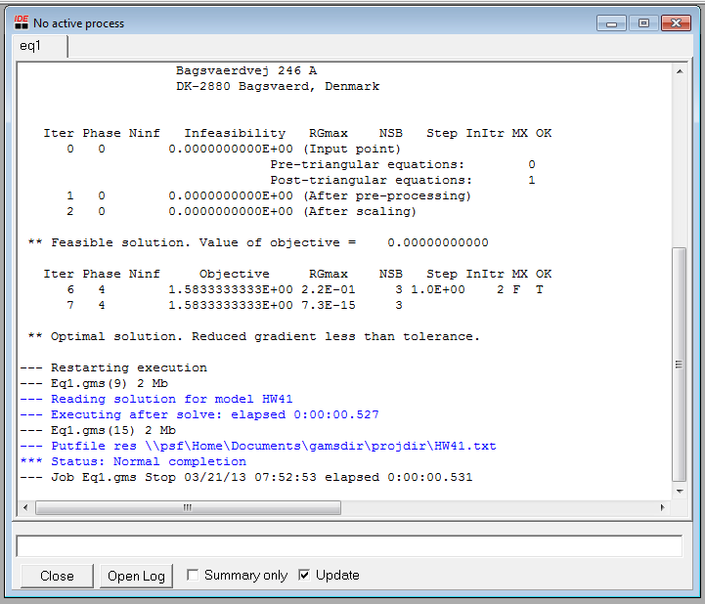
GAMS Model Results
Results are in file:
  HW41.txt
Double Click this line to open results file

Slide 13
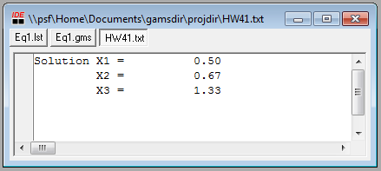
Viewing Results File
Note Tabs
Results

Slide 14

Another Example
Model
How to determine the coefficients: Least Squares Regression
Residual
Model
Observation

Slide 15
Observations
t | x1(t) | x2(t) | x3(t) | y(t)
1 | 2 | 30 | 1 | 10
2 | 3 | 60 | 6 | 20
3 | 3 | 70 | 7 | 30
4 | 3 | 60 | 3 | 20
5 | 5 | 80 | 5 | 40
6 | 5 | 90 | 9 | 50
7 | 6 | 100 | 8 | 60
8 | 7 | 100 | 17 | 70

Slide 16
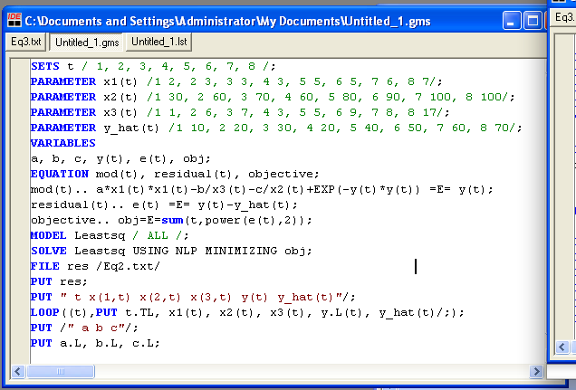
Second GAMS Code
Define Sets
& Data
Define Variables
Define Equations
Define &
Solve Model
Write Output

Slide 17
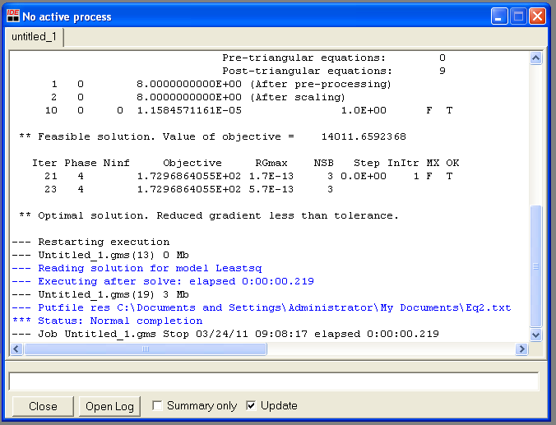
Results

Slide 18
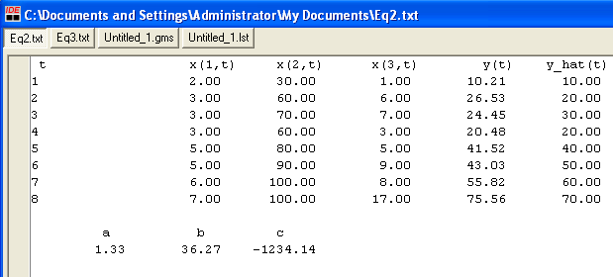
Results

Slide 19
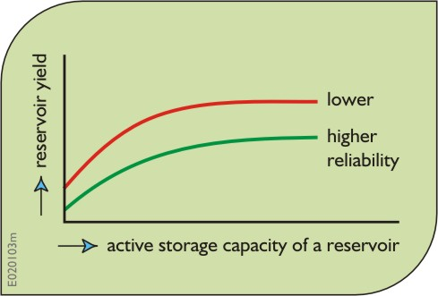
Capacity – Yield Example
Use linear programming in GAMS to derive a capacity-yield (K vs Y) function for a reservoir at a site having the following record of flows 5, 7, 8, 4, 3, 3, 2, 1, 3, 6, 8, 9, 3, 4, 9 units of flow.
Find the values of the capacity required for yields of 2, 3, 3.5, 4, 4.5, and 5.
Y
S_{t}
Y
Q_{t}
K
R_{t}
K

Slide 20
Capacity – Yield Curve
S_{t}
Y
Q_{t}
K
R_{t}
Y
K

Slide 21
Given a yield Y, what is the minimium capacity K we need?
Given
Find
Y | K
1.0
1.5
2.0
2.5
3.0
4.0
S_{t}
Y
Q_{t}
R_{t}
K

Slide 22
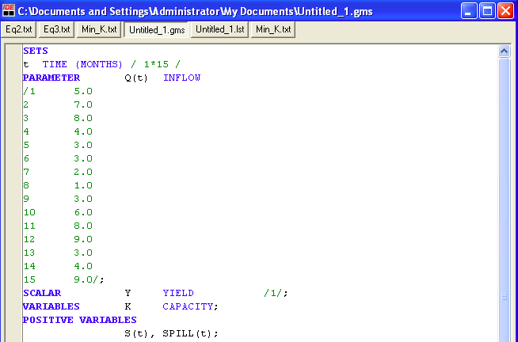
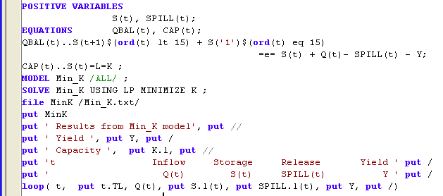
The GAMS Code

Slide 23
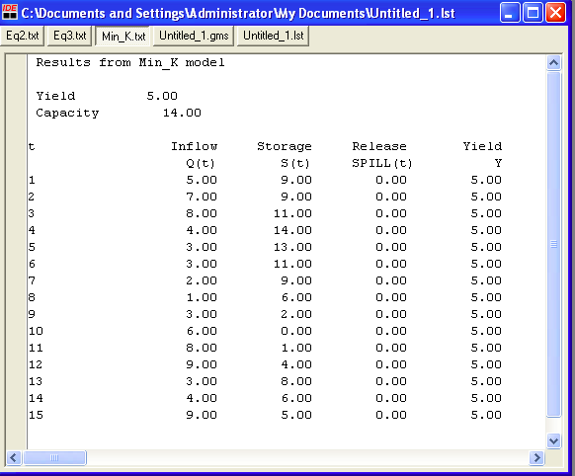
Results: Yield = 5, Capacity = 14

Slide 24
Results: Yield = 5, Capacity = 14
Capacity
Yield

Slide 25
Capacity vs Yield Curve

Slide 26
The DOLLAR Sign
S(t+1)$(ord(t) lt 15) + S('1')$(ord(t) eq 15) =e= S(t) + Q(t)- SPILL(t) - Y;
you can exclude part of an equation by using logical conditions ($ operator) in the name of an equation or in the computation part of an equation.
The ORD operator returns an ordinal number equal to
the index position in a set.

Slide 27
Management of a Single Reservoir
2 common tasks of reservoir modeling:
Determine coefficients of functions that describe reservoir characteristics
Determine optimal mode of reservoir operation (storage volumes, elevations and releases) while satisfying downstream water demands

Slide 28
Reservoir Operation
Compute optimal operation of reservoir given a series of inflows and downstream water demands
where:
S_{t} End storage period t, (L³);
S_{t-1} Beginning storage period t, (L³);
Q_{t} Inflow period t, (L³);
R_{t} Release period t, (L³);
D_{t} Demand, (L³); and
K Capacity, (L³)
S_{min} Dead storage, (L³)

Slide 29
Comparison of Average and Dry Conditions

Slide 30
GAMS Code
SCALAR K /19500/;
SCALAR S_min /5500/;
SCALAR beg_S /15000/;
SETS t / t1*t12/;
$include River1B_Q_Dry.inc
$include River1B_D.inc
$include River1B_Evap.inc
VARIABLES obj;
POSITIVE VARIABLES S(t), R(t);
S.UP(t)=K;
S.LO(t)=S_min;
Capacity
Dead storage
Beginning storage
These $include statements allow
Us to read in lines from other files:
Flows (Q)
Demands (D)
Evaporation (a_{t}, b_{t})
Set bounds on:
Capacity
Dead storage

Slide 31
GAMS Code (Cont.)
EQUATIONS objective, balance(t);
objective..
obj =E= SUM(t, (R(t)-D(t))*(R(t)-D(t)) );
balance(t)..
(1+a(t))*S(t) =E=
(1-a(t))*beg_S $(ord(t) EQ 1) +
(1-a(t))*S(t-1)$(ord(t) GT 1) +
Q(t) - R(t)- b(t);
First Time, t = 1, t-1 undefined
After First Time, t > 1, t-1 defined
We’ll preprocess these

Slide 32
$include Files
Flows (Q)
Demands (D)
Evaporation (a_{t}, b_{t})
Parameter
Q(t) inflow (million m3)
* dry
/
t1 375
t2 361
t3 448
t4 518
t5 1696
t6 2246
t7 2155
t8 1552
t9 756
t10 531
t11 438
t12 343
/;
Parameter
D(t) demand (million m3)
/
t1 1699.5
t2 1388.2
t3 1477.6
t4 1109.4
t5 594.6
t6 636.6
t7 1126.1
t8 1092.0
t9 510.8
t10 868.5
t11 1049.8
t12 1475.5
/;
Parameter
a(t) evaporation coefficient
/
t1 0.000046044
t2 0.00007674
…
t11 0.000103599
t12 0.000053718/;
Parameter
b(t) evaporation coefficient
/
t1 1.92
t2 3.2
…
t11 4.32
t12 2.24/;

Slide 33
Results
 | Storage | Input | Release | Demand
t0 | 15000
t1 | 13723 | 426 | 1700 | 1700
t2 | 12729 | 399 | 1388 | 1388
t3 | 11762 | 523 | 1478 | 1478
t4 | 11502 | 875 | 1109 | 1109
t5 | 12894 | 2026 | 595 | 595
t6 | 15838 | 3626 | 637 | 637
t7 | 17503 | 2841 | 1126 | 1126
t8 | 17838 | 1469 | 1092 | 1092
t9 | 18119 | 821 | 511 | 511
t10 | 17839 | 600 | 869 | 869
t11 | 17239 | 458 | 1050 | 1050
t12 | 16172 | 413 | 1476 | 1476

