Slide 1


Hydrologic Information Systems to discover and combine data from multiple sources for hydrologic analysis
David Tarboton
Utah State University
CUAHSI
HIS
Sharing hydrologic data
http://his.cuahsi.org/
Support
EAR 0622374

Slide 2
What proportion of your research time do you spend on preparing or preprocessing data into appropriate forms needed for research purposes?
http://his.cuahsi.org/documents/HISStatusSept15.pdf
Notes:
Surveys of the hydrology community have indicated that data gathering and preprocessing is an inordinate fraction of the time required for modeling and analysis
In hydrology most of the easy single site, single variable, low hanging fruit research problems are solved and advances in understanding and better predictions require
combining information from multiple sources,
sharing and collaboration
Easier access to advanced computational capability
Sustainability and reliability in software

Slide 3
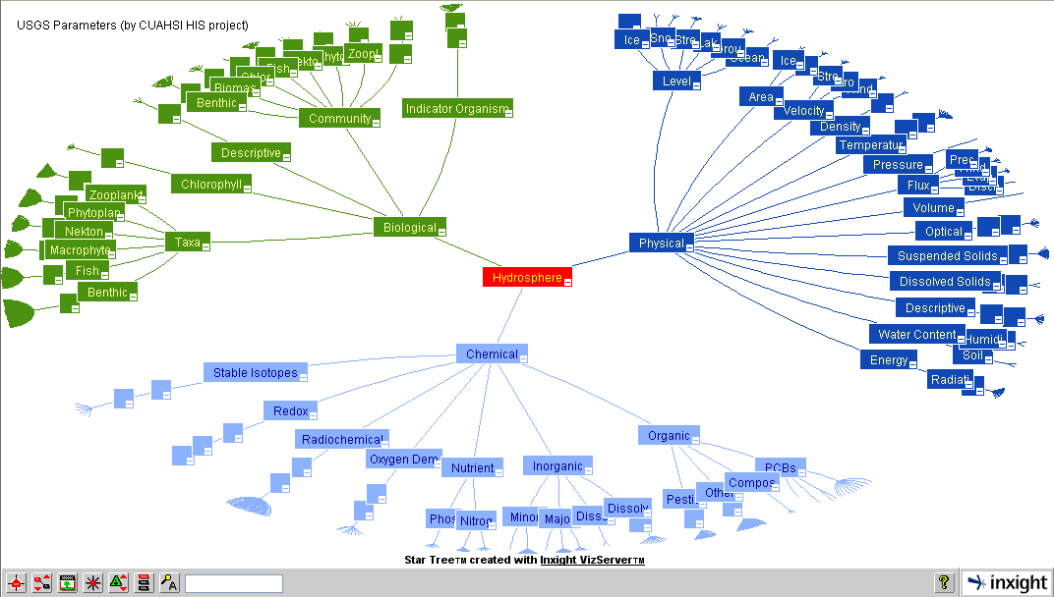
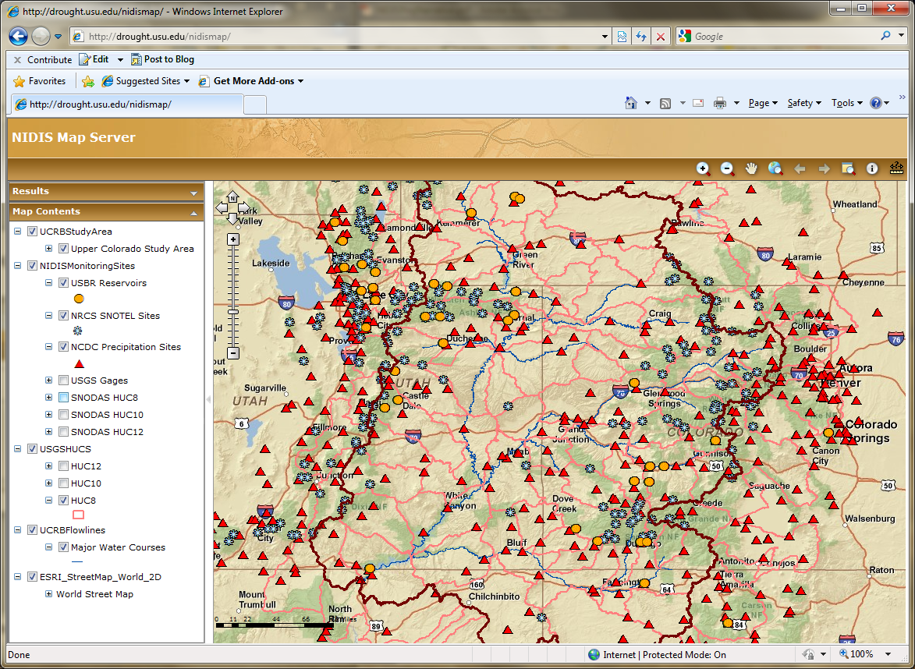
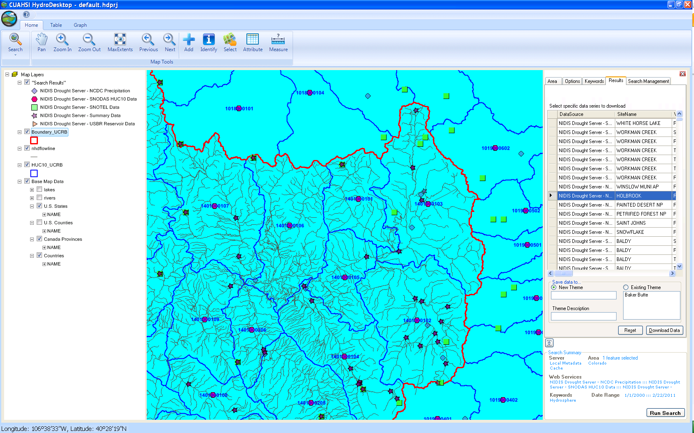
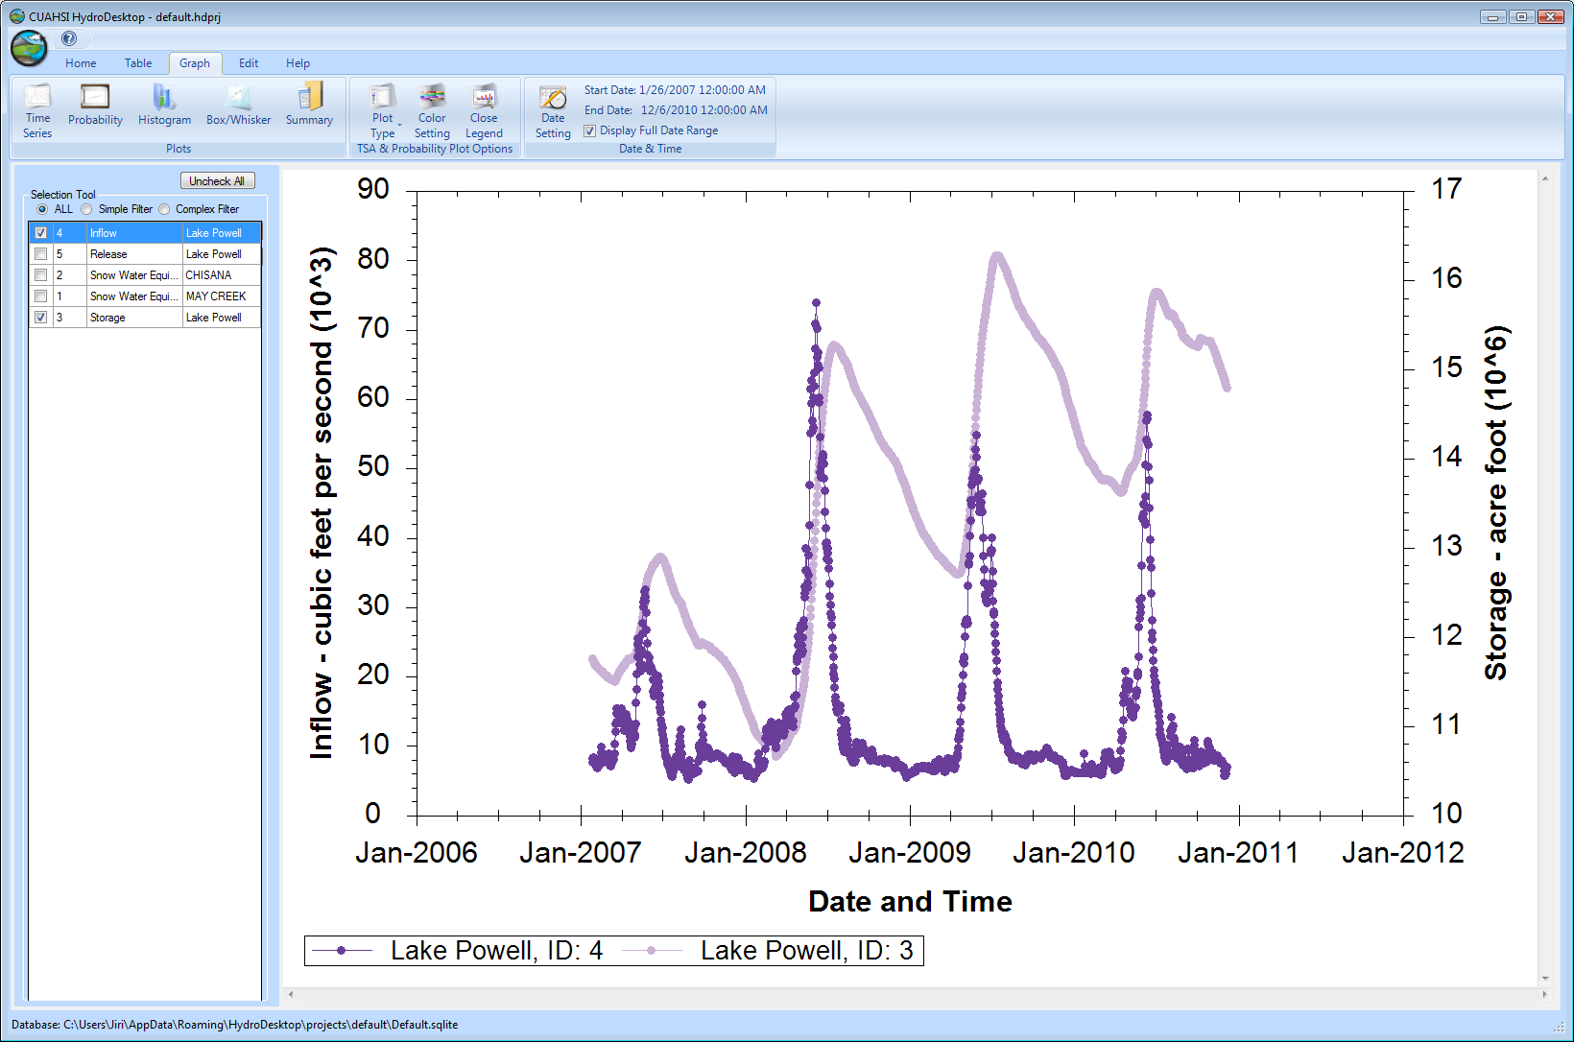
CUAHSI HIS
The CUAHSI Hydrologic Information System (HIS) is an internet based system to support the sharing of hydrologic data. It is comprised of hydrologic databases and servers connected through web services as well as software for data publication, discovery and access.
HydroServer – Data Publication
HydroCatalog
Data Discovery
Lake Powell Inflow and Storage
HydroDesktop – Data Access and Analysis
HydroDesktop – Combining multiple data sources

Slide 4
The CUAHSI Hydrologic Information System Team
University of Texas at Austin – David Maidment, Tim Whiteaker, James Seppi, Fernando Salas, Jingqi Dong, Harish Sangireddy
San Diego Supercomputer Center – Ilya Zaslavsky, David Valentine, Tom Whitenack, Matt Rodriguez
Utah State University – David Tarboton, Jeff Horsburgh, Kim Schreuders, Stephanie Reeder
University of South Carolina – Jon Goodall, Anthony Castronova
Idaho State University – Dan Ames, Ted Dunsford, Jiří Kadlec, Yang Cao, Dinesh Grover
Drexel University/CUNY – Michael Piasecki
CUAHSI Program Office – Rick Hooper, Yoori Choi, Jennifer Arrigo, Conrad Matiuk
ESRI – Dean Djokic, Zichuan Ye
Users Committee – Kathleen Mckee, Jim Nelson, Stephen Brown, Lucy Marshall, Chris Graham, Marian Muste
CUAHSI
HIS
Sharing hydrologic data
http://his.cuahsi.org/
Support
EAR 0622374

Slide 5
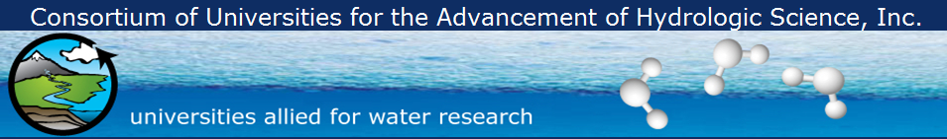
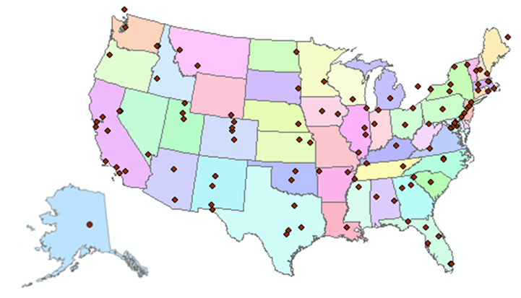
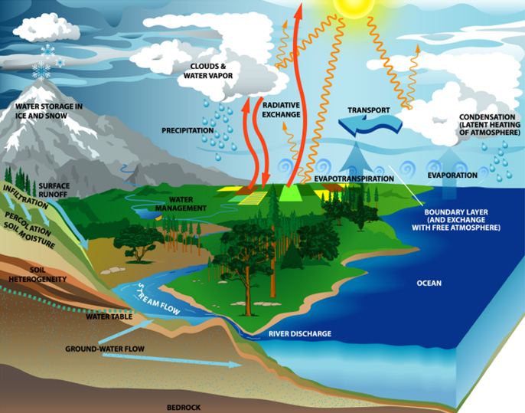

What is CUAHSI?
http://www.cuahsi.org
CUAHSI is a consortium representing 125 US universities (plus international affiliate members)
Supported by the National Science Foundation Earth Science Division
Advances hydrologic science in nation’s universities
Projects in Informatics, Instrumentation, Observatories, Synthesis, and Research Applications

Slide 6
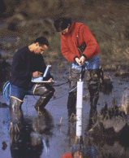


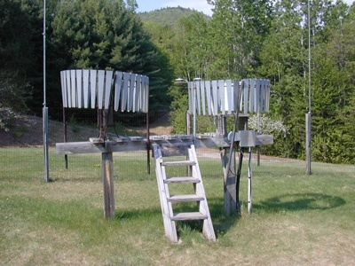
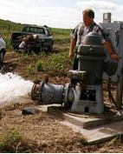
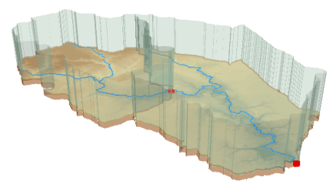
Hydrologic Data Challenges
Water quality
Water quantity
From dispersed federal agencies
From investigators collected for different purposes
Different formats
  Points
  Lines
  Polygons
  Fields
  Time Series
Rainfall and Meteorology
Soil water
Data Heterogeneity
Groundwater
The way that data is organized can enhance or inhibit the analysis that can be done
GIS

Slide 7

The way that data is organized can enhance or inhibit the analysis that can be done
I have your information right here …
Picture from: http://initsspace.com/

Slide 8
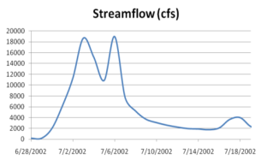
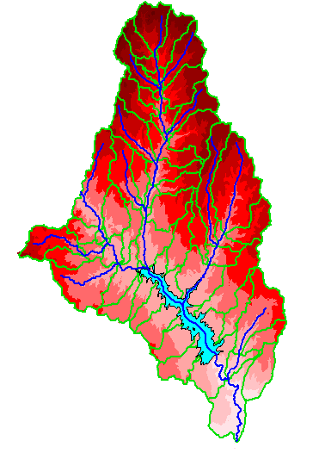
Hydrologic Science
It is as important to represent hydrologic environments precisely with
data as it is to represent hydrologic processes with equations
Physical laws and principles
(Mass, momentum, energy, chemistry)
Hydrologic Process Science
(Equations, simulation models, prediction)
Hydrologic conditions
(Fluxes, flows, concentrations)
Hydrologic Information Science
(Observations, data models, visualization
Hydrologic environment
(Physical earth)

Slide 9
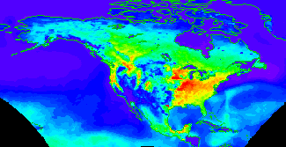


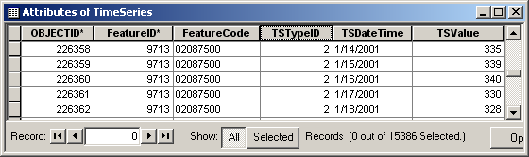

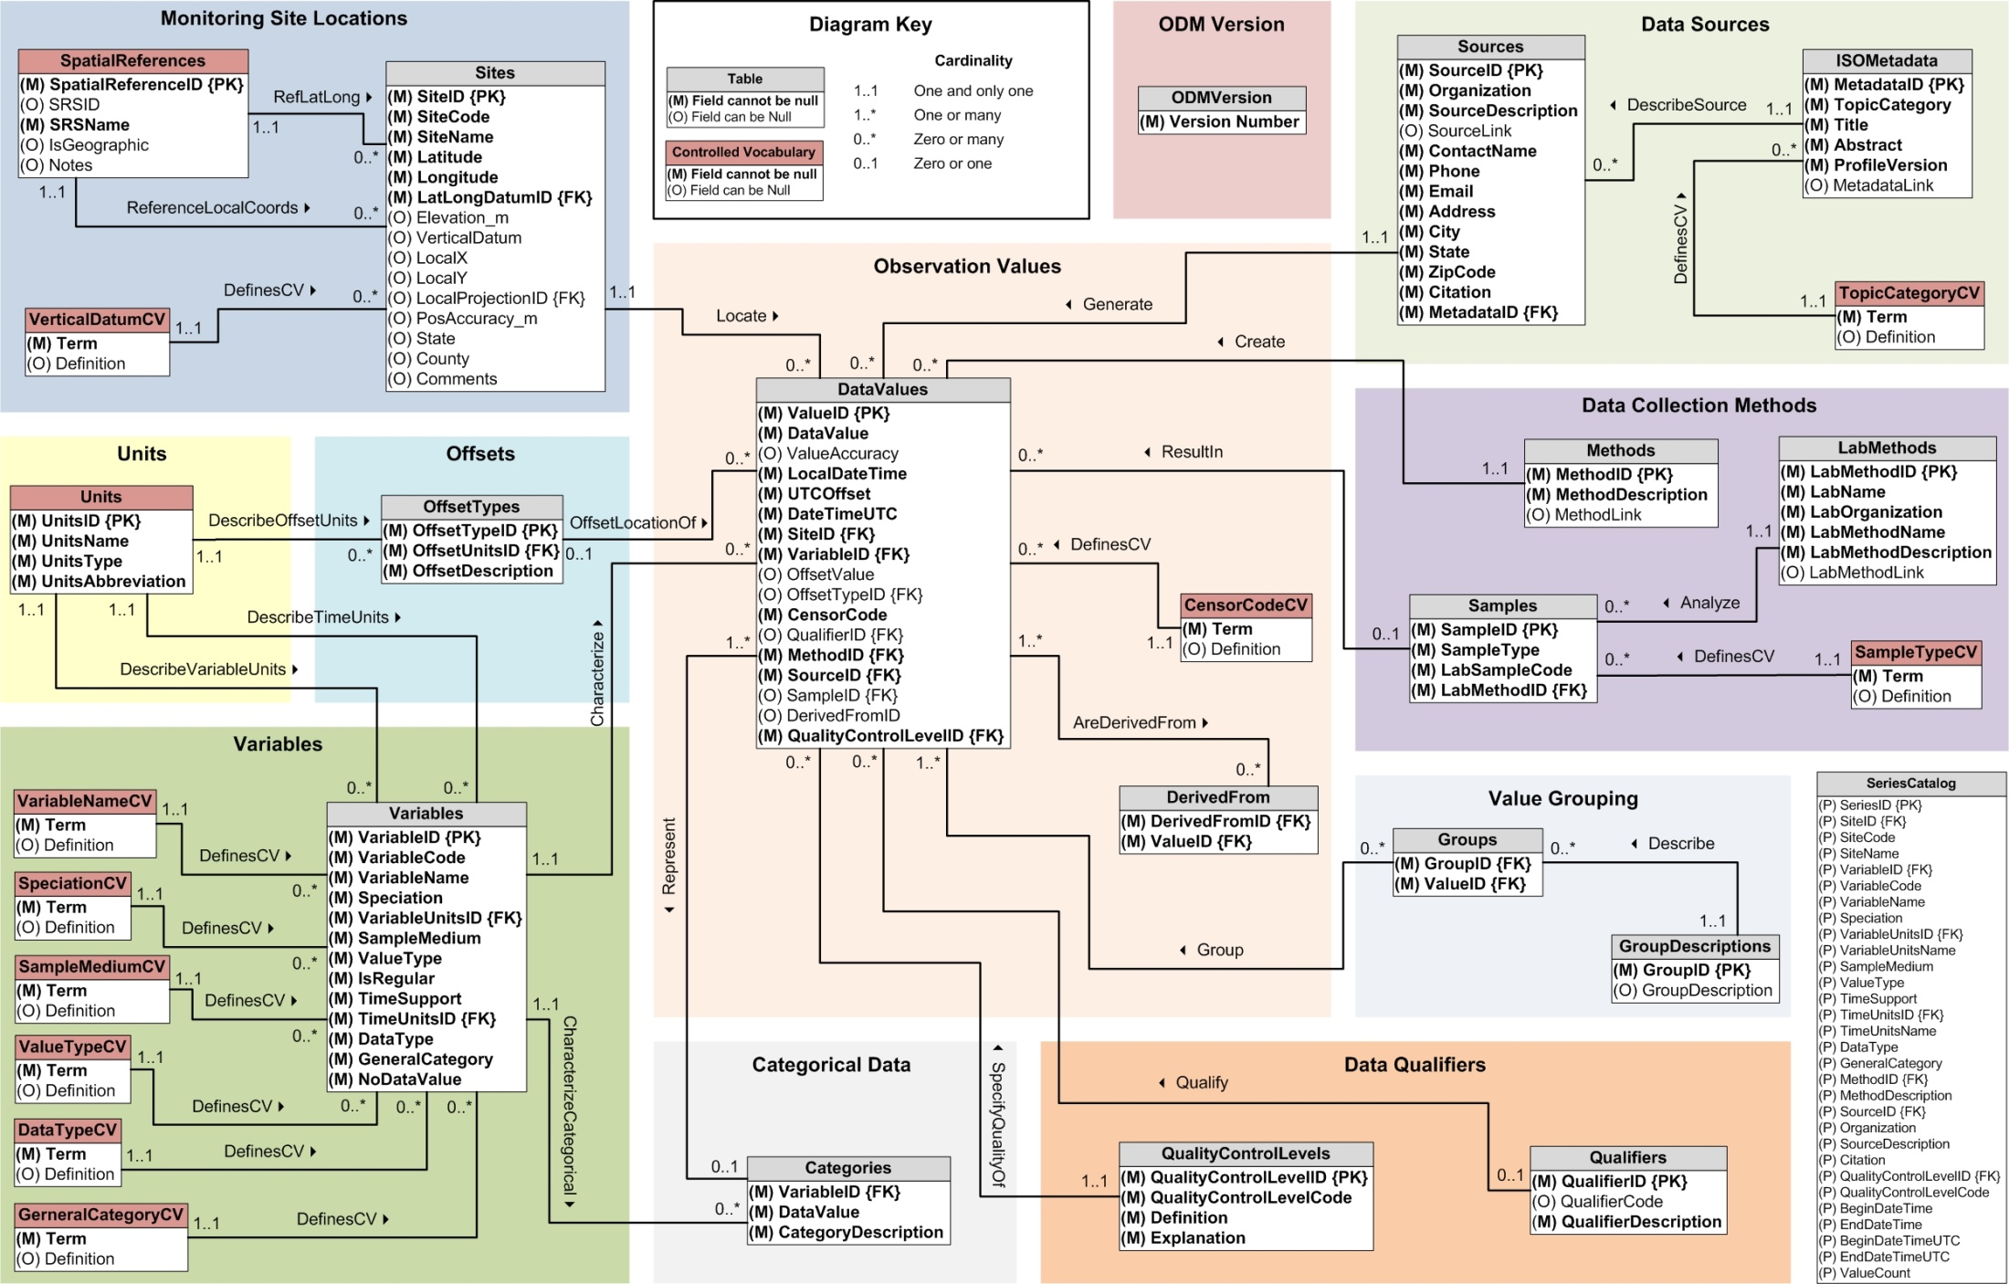
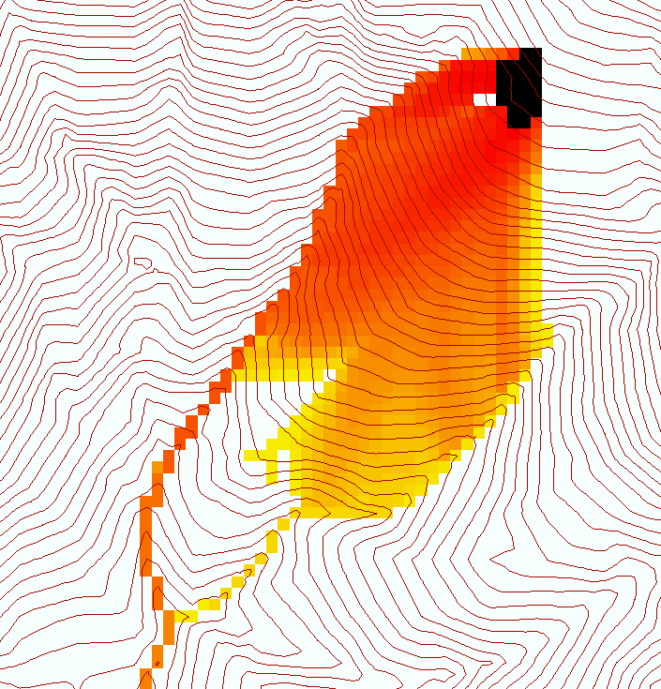
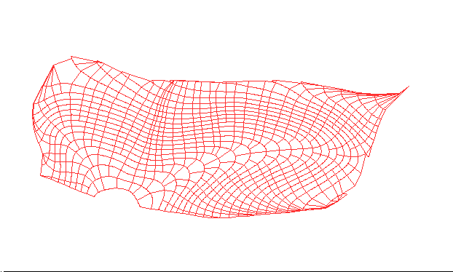

Data models capture the complexity of natural systems
NetCDF (Unidata) - A model for Continuous Space-Time data
ArcHydro – A model for Discrete Space-Time Data
Time, TSDateTime
Time, T
Coordinate
dimensions
{X}
TSValue
D
Space, FeatureID
Space, L
CUAHSI Observations Data Model: What are the basic attributes to be associated with each single data value and how can these best be organized?
Variables, TSTypeID
Variables, V
Variable dimensions
{Y}
Terrain Flow Data Model used to enrich the information content of a digital elevation model

Slide 10










Data Searching – What we used to have to do
Searching each data source separately
NWIS
request
return
request
request
return
return
NAWQA
request
return
NAM-12
request
return
request
return
request
return
request
return
NARR
Michael Piasecki
Drexel University
Notes:
10

Slide 11

What HIS enables
Searching all data sources collectively
GetValues
GetValues
NWIS
GetValues
GetValues
generic
request
GetValues
GetValues
NAWQA
Michael Piasecki
Drexel University
GetValues
NARR
GetValues
ODM
Notes:
11

Slide 12
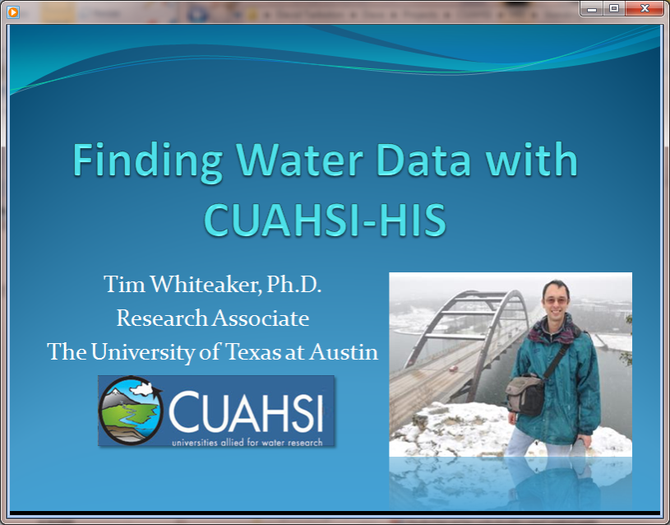
Video Demo
http://his.cuahsi.org/movies/JacobsWellSpring/JacobsWellSpring.html

Slide 13
Web Paradigm
Catalog
(Google)
Catalog harvest
Search
Web Server
(CNN.com)
Access
Browser
(Firefox)

Slide 14


CUAHSI Hydrologic Information System
Services-Oriented Architecture
Data Discovery and Integration
HydroCatalog
Metadata Services
WaterML, Other OGC Standards
Search Services
HydroServer
HydroDesktop
Data Publication
Data Services
Data Analysis and Synthesis
ODM
Geo Data
Information Model and Community Support Infrastructure

Slide 15
What are the basic attributes to be associated with each single data value and how can these best be organized?
DateTime
Interval (support)
“When”
Time, T
t
A data value
v_{i} (s,t)
Variable
Method
Quality Control Level
Sample Medium
Value Type
Data Type
Source/Organization
“Where”
Location
Feature of interest
Latitude
Longitude
Site identifiers
s
Space, S
V_{i}
“What”
Variables, V
Units
Accuracy
Censoring
Qualifying comments

Slide 16
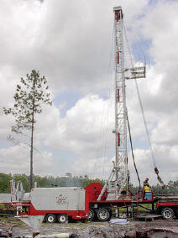
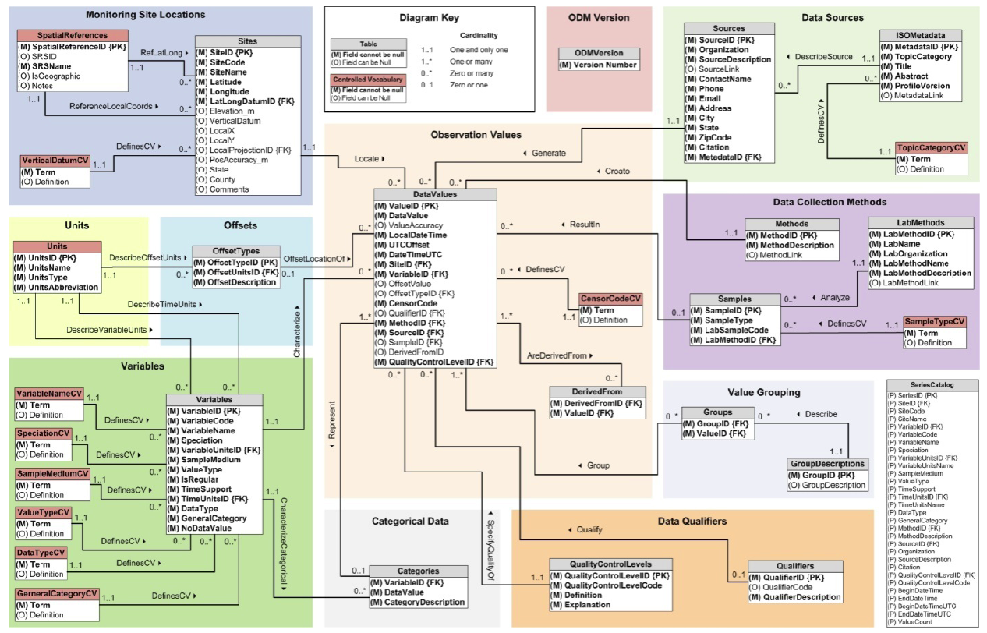
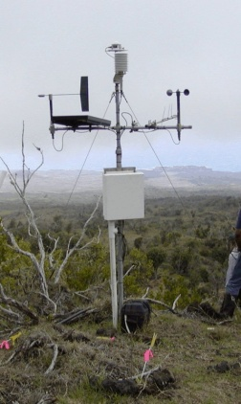
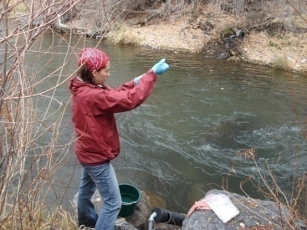
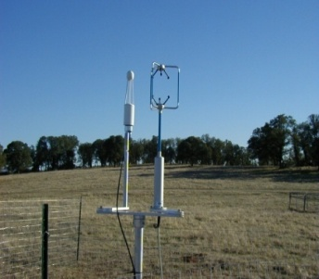
Observations Data Model (ODM)
Streamflow
Provides a common persistence model for data storage
Groundwater
levels
Precipitation
& Climate
Soil
moisture
data
Water Quality
Flux tower data
A relational database at the single observation level
Metadata for unambiguous interpretation
Traceable heritage from raw measurements to usable information
Promote syntactic and semantic consistency
Cross dimension retrieval and analysis
Horsburgh, J. S., D. G. Tarboton, D. R. Maidment, and I. Zaslavsky (2008), A relational model for environmental and water resources data, Water Resources Research, 44, W05406, doi:10.1029/2007WR006392.

Slide 17
CUAHSI Observations Data Model http://his.cuahsi.org/odmdatabases.html
Horsburgh, J. S., D. G. Tarboton, D. R. Maidment and I. Zaslavsky, (2008), A Relational Model for Environmental and Water Resources Data, Water Resour. Res., 44: W05406, doi:10.1029/2007WR006392.
Notes:
In designing ODM we asked: What are the basic attributes to be associated with each single data value and how can these best be organized? This involved community survey at a workshop and by email and based on the feedback received we came up with the ODM schema illustrated, published last year in WRR
This is quite a detailed slide, but it is the entire schema. Few database designs are simple enough to fit the entire schema on one slide. This shows at the center the data values table and off to the sides, the ancillary or metadata tables that record.

Slide 18
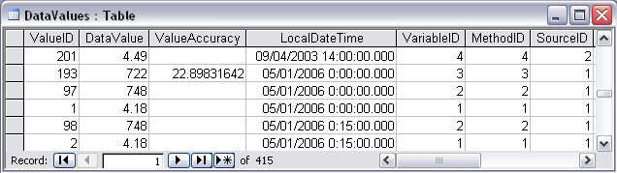
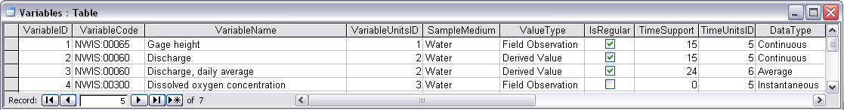
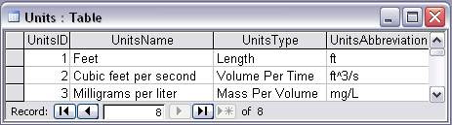
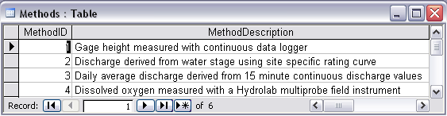
Discharge, Stage, Concentration and Daily Average Example

Slide 19
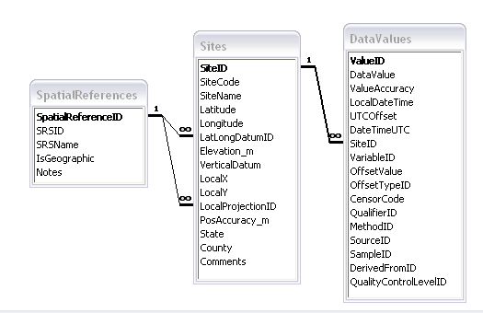
Site Attributes
SiteCode, e.g. NWIS:10109000
SiteName, e.g. Logan River Near Logan, UT
Latitude, Longitude Geographic coordinates of site
LatLongDatum Spatial reference system of latitude and longitude
Elevation_m Elevation of the site
VerticalDatum Datum of the site elevation
Local X, Local Y Local coordinates of site
LocalProjection Spatial reference system of local coordinates
PosAccuracy_m Positional Accuracy
State, e.g. Utah
County, e.g. Cache

Slide 20
Independent of, but can be coupled to Geographic Representation
ODM
e.g. Arc Hydro
Feature
Observations Data Model
1
HydroPoint
Waterbody
Watershed
Sites
1
HydroID
HydroID
HydroID
SiteID
HydroCode
*
HydroCode
HydroCode
SiteCode
FType
FType
DrainID
SiteName
OR
Name
Name
AreaSqKm
Latitude
JunctionID
AreaSqKm
JunctionID
Longitude
JunctionID
NextDownID
…
ComplexEdgeFeature
*
SimpleJunctionFeature
*
CouplingTable
1
SiteID
HydroID
1
HydroEdge
HydroJunction
HydroJunction
HydroID
1
HydroJunction
1
HydroID
HydroID
HydroCode
HydroID
HydroCode
HydroCode
ReachCode
HydroCode
NextDownID
NextDownID
Name
NextDownID
LengthDown
LengthDown
LengthKm
HydroNetwork
LengthDown
DrainArea
DrainArea
LengthDown
DrainArea
FType
FType
FlowDir
FType
Enabled
Enabled
FType
Enabled
AncillaryRole
AncillaryRole
EdgeType
AncillaryRole
Enabled
EdgeType
Flowline
Shoreline

Slide 21
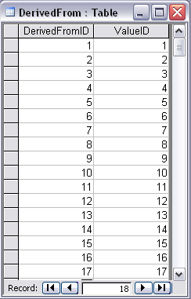
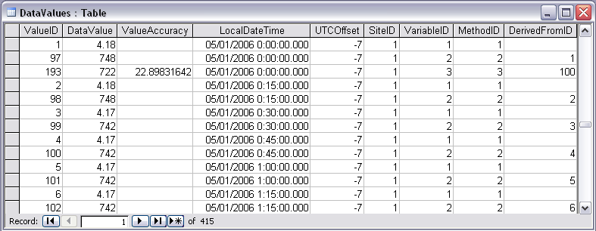
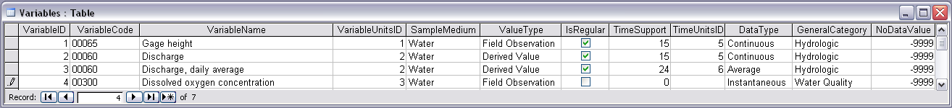
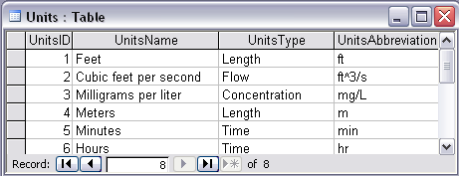
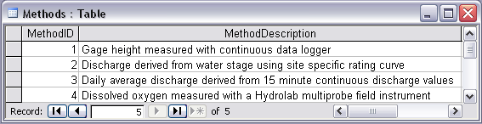
Stage and Streamflow Example
Notes:
Discharge Derived from Gage Height
Concepts:
Data derived from other data – single data point derived from a single observation (discharge from stage)
Data derived using a specific method (discharge from stage using rating curve)
Relationships:
Relationships between Values table and DerivedFrom table on DerivedFromID and ValueID
Relationship between Values table and Variables table on VariableID
Relationship between Values table and Methods table on MethodID
Relationship between Variables table and Units table on UnitID

Slide 22
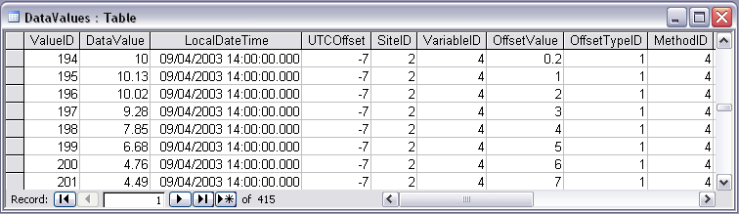

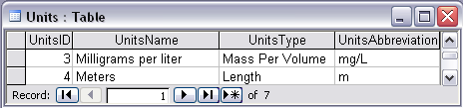
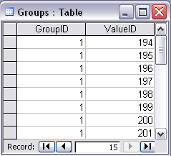


Water Chemistry from a profile in a lake
Notes:
Water Chemistry From a Lake Profile
Concepts:
Grouped observations (all observations in one reservoir profile)
Observations made using an offset (observations made at multiple depths below the surface of a reservoir)
Observations made using a specific method (observations made using a particular field instrument)
Relationships:
Relationship between Values table and the Variables table on VariableID
Relationship between Values table and OffestTypes table on OffsetTypeID
Relationship between Values table and Methods table on MethodID
Relationship between Variables table and Units table on UnitID
Relationship between GroupDescriptions table and Groups table on GroupID
Relationship between OffsetTypes table and Units table on UnitID and OffsetUnitID

Slide 23
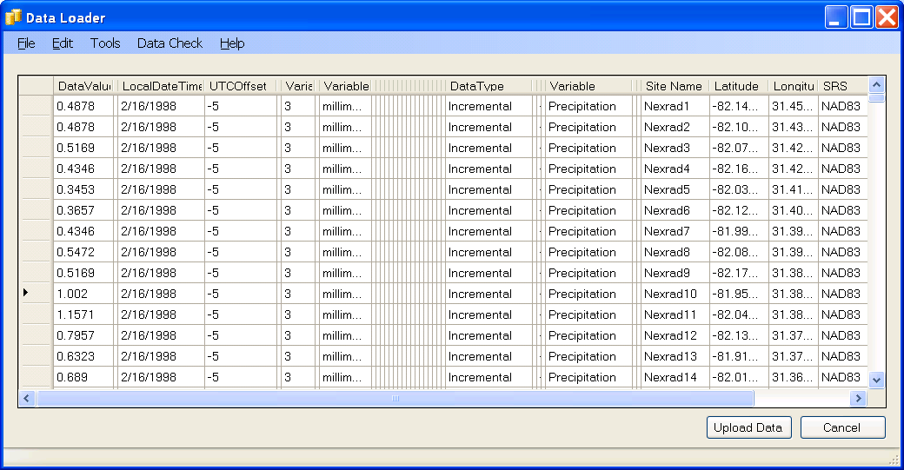
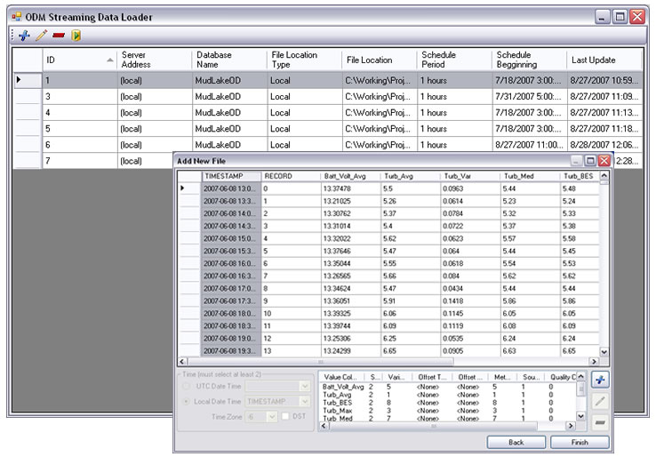
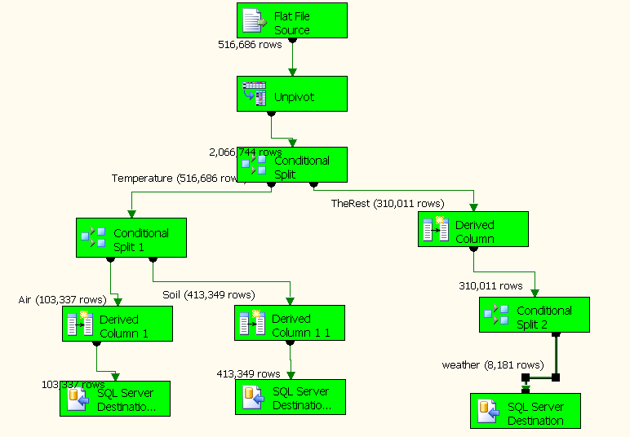
Loading data into ODM
OD Data Loader
Interactive OD Data Loader (OD Loader)
  Loads data from spreadsheets and comma separated tables in simple format
Scheduled Data Loader (SDL)
  Loads data from datalogger files on a prescribed schedule.
  Interactive configuration
SQL Server Integration Services (SSIS)
  Microsoft application accompanying SQL Server useful for programming complex loading or data management functions
SDL
SSIS

Slide 24
Importance of the Observations Data Model
Provides a common persistence model for observations data
Syntactic consistency (File types and formats)
Semantic consistency
  Language for observation attributes (structural)
  Language to encode observation attribute values (contextual)
Publishing and sharing research data
Metadata to facilitate unambiguous interpretation
Enhance analysis capability

Slide 25
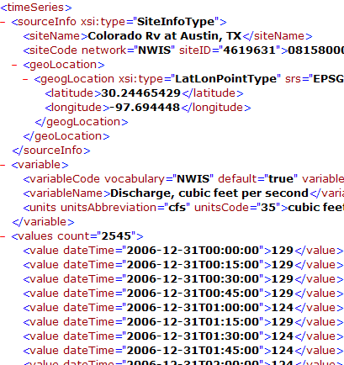
WaterML and WaterOneFlow
WaterML is an XML language for communicating water data
WaterOneFlow is a set of web services based on WaterML
Set of query functions
Returns data in WaterML
GetSites
GetSiteInfo
GetVariableInfo
GetValues
WaterOneFlow
Web Service
Notes:
25

Slide 26
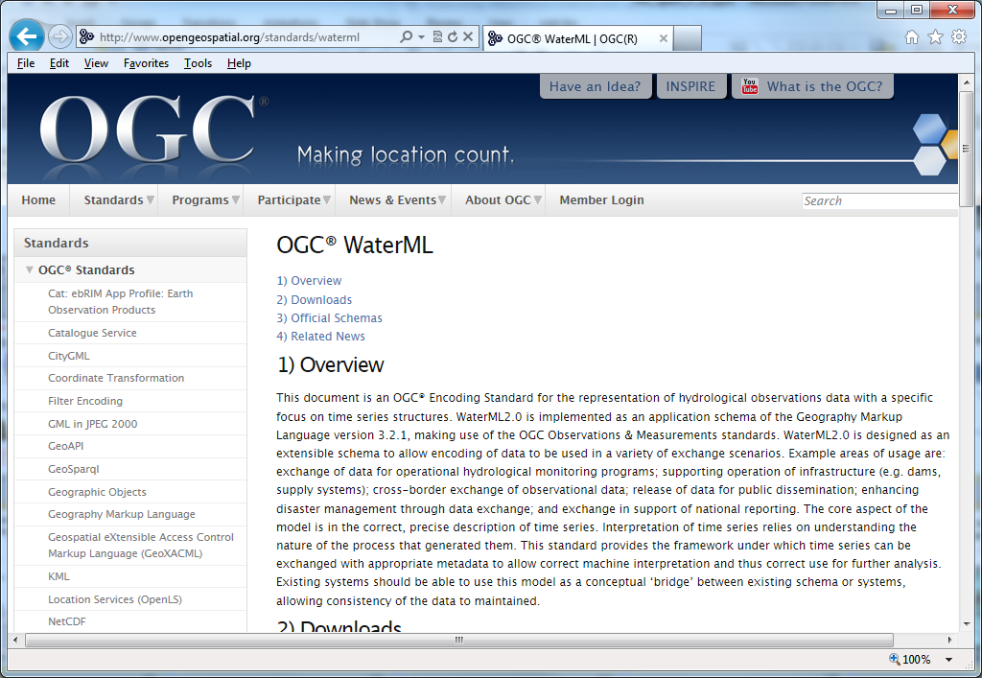
Open Geospatial Consortium Web Service Standards
http://www.opengeospatial.org/standards/waterml
This document is an OGC® Encoding Standard for the representation of hydrological observations data with a specific focus on time series structures.
These standards have been developed over the past 10 years …. by 400 companies and agencies ....

Slide 27
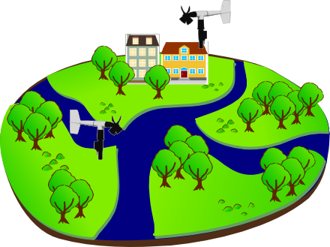
Sensor Observations Service: Get Observation
Observed Property := “Wind_Speed“
Sampling Time
Result
Feature of Interest
23 m/s 16.9.2010 13:45
uom
Procedure (ID := “DAVIS_123“)
Observation
Notes:
Basis for a standardized access to sensor data is the observation model defined in the Observations & Measurements standard. Let me briefly describe the main concepts / terms used in this model…

Slide 28
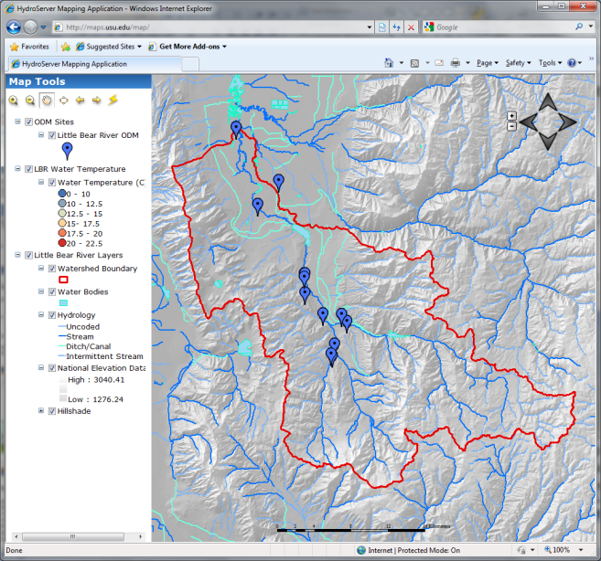

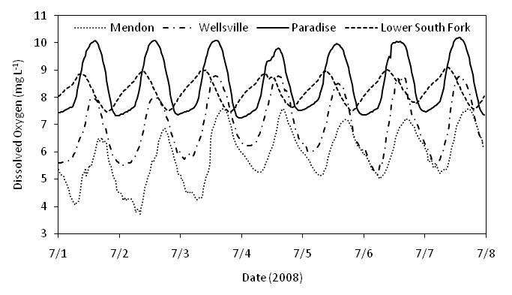

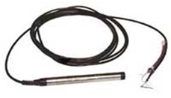
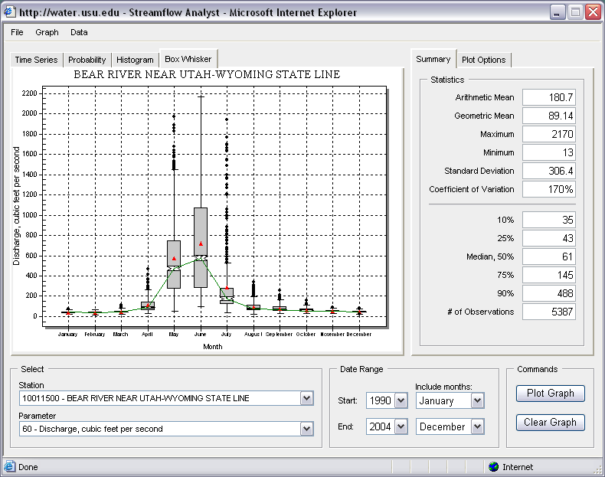
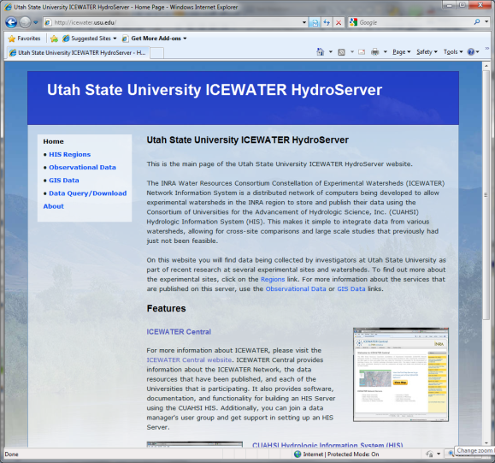

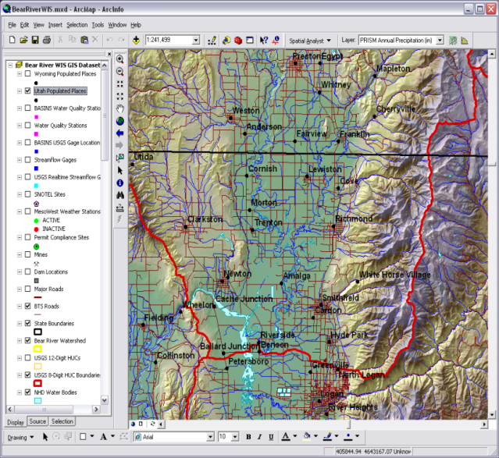
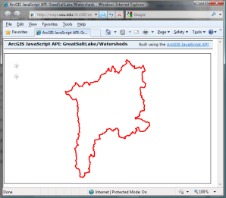
HydroServer – Data Publication
Point Observations Data
Internet Applications
Ongoing Data Collection
Historical Data Files
ODM Database
GetSites
GetSiteInfo
GetVariableInfo
GetValues
GIS Data
WaterML
WaterOneFlow
Web Service
OGC Spatial Data Service from ArcGIS Server
Data presentation, visualization,
and analysis through Internet enabled applications
Notes:
A platform for publishing space-time hydrologic datasets that:
Autonomous with local control of data
Part of a distributed system that makes data universally available
Basis for Experimental Watershed or Observatory data management system
Standards based approach to data publication
Accepted and emerging standards for data storage and transfer (OGC, WaterML)
Built on established software
MS SQL Server, ArcGIS server
Open Source Community Code Repository
Sustainability

Slide 29




HydroCatalog
Service Registry
Hydrotagger
Search over data services from multiple sources
Supports concept based data discovery
WaterML
Harvester
Water Metadata Catalog
GetSites
GetSiteInfo
GetVariableInfo
GetValues
WaterOneFlow
Web Service
Search Services
CUAHSI Data Server
3rd Party Server
e.g. USGS
Discovery and Access
Hydro
Desktop
http://hiscentral.cuahsi.org

Slide 30

Overcoming Semantic Heterogeneity
ODM Controlled Vocabulary System
  ODM CV central database
  Online submission and editing of CV terms
  Web services for broadcasting CVs
ODM VariableNameCV
Variable Name
Term
…
Sunshine duration
Temperature
Turbidity
…
Investigator 1: | “Temperature, water”
Investigator 2: | “Water Temperature”
Investigator 3: | “Temperature”
Investigator 4: | “Temp.”
From Jeff Horsburgh

Slide 31





Dynamic controlled vocabulary moderation system
ODM Data Manager
ODM Website
ODM
Tools
ODM Controlled
Vocabulary Moderator
XML
Master ODM Controlled Vocabulary
Local ODM
Database
ODM
Controlled Vocabulary
Web Services
Local
Server
http://his.cuahsi.org/mastercvreg.html
From Jeff Horsburgh

Slide 32

Thematic keyword search
HydroDesktop – Data Access and Analysis
Integration from multiple sources
Search on space and time domain

Slide 33

HydroModeler
An integrated modeling environment based on the Open Modeling Interface (OpenMI) standard and embedded within HydroDesktop
Integrated modeling within a Hydrologic Information System: An OpenMI based approach, Castronova, A.M., Goodall, J.L., Ercan, M,B. Environmental Modelling & Software, In Press. 10.1016/j.envsoft.2012.02.011.

Slide 34


Service Orientation of Hydrologic Models
A service-oriented modeling approach is needed to overcome platform dependencies, computer architecture requirements, or programming language incompatibilities that exist between models within an integrated software system.
Client Wrapper – generic OpenMI component for wrapping web resources on-the-fly
WPS Services – models implemented as WPS resources
Models are designed as web resources using the PyWPS implementation of the OGC WPS data specification on a RESTful web server.
Service orientation involves decomposing a larger software system into independent
distributed components. The client-server interaction (above) is very similar to the loose integration paradigm.
Models as web services using the Open Geospatial Consortium (OGC) Web Processing Service (WPS) standard, Castronova, A. M., Goodall, J. L., Elag, M.M. , Environmental Modelling & Software, In Review

Slide 35

Integration with “R” Statistics Package

Slide 36

A growing collection of HydroServers and community of users
University of Maryland, Baltimore County
Montana State University
University of Texas at Austin
University of Iowa
Utah State University
University of Florida
University of New Mexico
University of Idaho
Boise State University
University of Texas at Arlington
University of California, San Diego
Idaho State University
Dry Creek Experimental Watershed (DCEW)
(28 km² semi-arid steep topography, Boise Front)
68 Sites
24 Variables
4,700,000+ values
Published by Jim McNamara, Boise State University

Slide 37

Open Development Model
http://hydrodesktop.codeplex.com
http://hydroserver.codeplex.com
http://hydrocatalog.codeplex.com

Slide 38
General aspects of the approach
Common functional components
Storage in a community data model
Publication from a server
Data access through internet-based services using consistent language and format
Tools for access and analysis
Discovery through thematic and geographic search functionality
Integrated modeling and analysis combining information from multiple sources
Discovery and Integration
Catalog
Discoverability
Metadata Services
Search Services
Standards
Server
Desktop/Client
Publication
Synthesis and Research
Data Services
Accessibility
Consumability
Information Model and Community Support Infrastructure
The combination of these capabilities creates a common window on water observations data for the United States unlike any that has existed before.

Slide 39
Looking to the Future
Move from prototype to operations
  Operational support of software and systems
  User support and training
  Repositories
  CUAHSI Data Center
Hydroshare
  An online, environment to be developed for the sharing of hydrologic data and models
  To expand data sharing capability of CUAHSI HIS
    Additional data classes
    Models, scripts, tools and workflows
    Collaboration/social networking
Community
  HIS has become bigger than one project
  Open Development Model to coordinate community contributions

Slide 40





HydroShare
Collaboration
Create
Visualization
Social Media
Read
HydroDesktop
Update
Models
Delete
Data
WPS
Your favorite ...
Data.gov
Earth
Exchange
HPC
CSDMS
CUAHSI
HydroServer
Notes:
HydroShare is a system that we have proposed to address these issues. It will be an online collaborative environment for sharing hydrologic data and models aimed at giving hydrologist the technology infrastructure they need to address critical issues related to water quantity, quality, accessibility, and management. HydroShare will expand the data sharing capability of the CUAHSI Hydrologic Information System by broadening the classes of data accommodated, expanding capability to include the sharing of models and model components, and taking advantage of emerging social media functionality to enhance information about and collaboration around hydrologic data and models. We plan to develop sustainable cyberinfrastructure, basically a website, for better access to water-related data and models in the hydrologic sciences. Social media functionality will help users be better informed of the use and value of data and models so as to discover the information and tools most relevant to their needs as well as stimulate the combination of data and coupling of models from multiple sources and catalyze sharing and collaboration. We envisage that the system will help hydrologists more easily access water-related research data and models that are online, retrieve them to their desktops, and perform analyses that could include accessing other models or using computing systems in the cloud or in distributed grid infrastructures. This project is funded from 2012-2017.
I have worked for 20+ years on hydrologic modeling and have codes that are widely used as well as that have died of neglect. I have also had projects whose data is nicely organized in CUAHSI HIS and others where the data is buried in private files. I would like to develop this system to do better.
HydroShare will be a social media based web site that provides access to hydrologic data and models. It will contain its own resources as well as links to external resources, e.g. web services from the USGS or CUAHSI HydroServers. It will interact with other data and modeling systems such as NASA earth exchange and provide easy to use access to HPC resources e.g. at CSDMS.
HydroShare will be directly accessible to serve as a portal for collaboration among hydrologists. We recognize that there are a lot of collaboration websites being developed, so will focus on providing hydrology value added functionality in terms of access to data and models. HydroShare will also have a web services interface, building on CUAHSI HIS that provides access from desktop software such as HydroDesktop and R.

Slide 41


Can sharing data and models be as easy as sharing photos on Facebook or videos on YouTube?
Notes:
In short, we would like to see if sharing hydrologic data and models can be as easy as sharing photos on Facebook or videos on YouTube.

Slide 42


Can finding data and models be as easy as shopping on Amazon?
Possible Filters
Available Formats
Items
Recommendations
Prices (perhaps usage)
Notes:
Or whether finding data and models can be as easy as shopping on Amazon, and perhaps not as heavy on your credit card.
List of items also includes other providers, aka not shipped by amazon.
List of data shows ‘facets’
,
Items show formats recommendations. Add-in shows pricetracking

Slide 43


Sign In | Settings | Notifications | Feedback | Help
HYDROSHARE
Dashboard
Recent Activity
My Content
View Your Resources
Explore
Discover Resources
Collaborate
Share with colleagues
Share and Collaborate
HydroShare is an online collaboration environment for sharing data, models, and code. Join the community to start sharing.
HydroShare Gallery
How HydroShare Works
Getting Started
Getting Started
What’s New
Provide feedback
HydroShare Blog
Developers
Partners
CUAHSI
CUAHSI HIS
CUAHSI Water Data Center
Terms of Use | Statement of Privacy| Copyright © 2012 CUAHSI
This material is based upon work supported by the National Science Foundation (NSF) under Grants No. OCI-1148453, OCI-1148090
Any opinions, findings, conclusions, or recommendations expressed in this material are those of the authors and do not necessarily reflect the views of the NSF.
Notes:
Home Page
Gallery – shows featured, new, or highly rated resources (data, code, models, workflows, etc.)
Could have separate galleries for models, code, data, etc.
Top Bar Items
Sign in
Settings
Create a HydroShare profile
Choose display preferences
Choose default privacy (share everything or choose what to share)
Account information (password, etc.)
Notifications - messages from the HydroShare team (choose to receive notifications from HydroShare)
Help

Slide 44






You are signed in as Jeff Horsburgh | Settings | Notifications | Feedback | Help
HYDROSHARE
Dashboard
Recent Activity
My Content
View Your Resources
Explore
Discover Resources
Collaborate
Share with colleagues
Recent Activity
All activity | Only my activity
Profile
Little Bear River ODM
Database 6/6/2012
Jeff Horsburgh
Utah State University
jeff.horsburgh@usu.edu
Little Bear River Sites 6/6/2012
Little Bear River Excel File 6/6/2012
Resources You May Like
Little Bear River SWAT Model
Shared by: David Tarboton
Watershed delineation Workflow 6/6/2012
Abstract: Time series of water quality sensor data in the Little Bear River, Utah, USA
Keywords: Temperature, Dissolved Oxygen, pH, Specific Conductance, Turbidity
Little Bear River DEM
Shared by: David Tarboton
More
View Details
You Should Follow
People | Groups
Announcements
What’s New at HydroShare: Click here to visit the HydroShare blog to learn more about recent updates and new HydroShare features.
Jeff Horsburgh
Utah State University
David Tarboton
Utah State University
Terms of Use | Statement of Privacy| Copyright © 2012 CUAHSI
This material is based upon work supported by the National Science Foundation (NSF) under Grants No. OCI-1148453, OCI-1148090
Any opinions, findings, conclusions, or recommendations expressed in this material are those of the authors and do not necessarily reflect the views of the NSF.
Notes:
Dashboard
A user's home page
Shows user information/profile
Lists recent HydroShare activity in multiple categories (user's recent activity, all recent activity)
Announcements from HydroShare team
Suggests datasets the user might be interested in (geographic proximity, similar variables, similar time period, aggregations, keywords)
Suggests people that the user might want to "follow"
Suggests groups that the user might be interested in

Slide 45
Architecture
Browser Interface
Dashboard, Explore, Visualization, Modeling, Collaborate, Support
Management Interface (Browser)
• Configure
• Set permissions
HydroShare Portal
Service Interface
• Discovery API calls
• Create resource API
• Read resource API
• Update resource API
• Delete resource API
• Modeling API
R, MATLAB, HydroDesktop, ArcGIS, IDV, Python
Authentication and Access control
Users
Discovery Tools
Visualization Tools
Modeling Tools
Social Media
Resource Catalog
Resource Store
Model Store
Social Media Data and information
Objects
Rules
Model Metadata
Models
External
Internal
External Resource Interface
Resource Data Model
(Information about resources that are stored)
• Full metadata
• Data cart metadata
• Data discovery metadata
Data Model for Models
(Information Models and What it takes to run them on available compute resources)
• Many details to work out
External Catalog (e.g. HydroCatalog)
External Data Sources
HPC Cluster
Desktop Compute Resources

Slide 46


Questions ?
You are signed in as David Tarboton | Settings | Notifications | Feedback | Help
HYDROSHARE
Share
Your Resources
Explore
Discover Resources
Collaborate
Interact with colleagues
Summary
Simple and easy to use
Data and model sharing enabled by open standards based metadata
Find, create, share, connect, interact, work together online
Archive data collections accompanying research publications in easily accessible way
Integration and synthesis across data collections
To participate
See http://his.cuahsi.org
Join his@sdsc.edu
Write dtarb@usu.edu
Terms of Use | Statement of Privacy| Copyright © 2012 CUAHSI
This material is based upon work supported by the National Science Foundation (NSF) under Grants No. OCI-1148453, OCI-1148090
Any opinions, findings, conclusions, or recommendations expressed in this material are those of the authors and do not necessarily reflect the views of the NSF.

